Slide 1
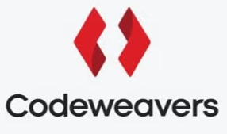

Transforming the Future with DigitalTwins (DT) and GenAI
Staffs Web Meetup at Codeweavers
Speaker: Dr. Mehak Memon
Academic & Researcher
Lecturer, Liverpool John Moores University

Slide 2
Table of contents
01
02
03
04
05
06
Digital Twin
DT Mechanics
DT Applicability
Components and Types
Working, Catgorisation and Benefits
Industry Use cases and AI Integration
UK Job Market
Start up Guide
Way Forward
Skills and Roles in Demand
Implementation, Tools & Platforms
Challenges, Considerations and Future

Slide 3
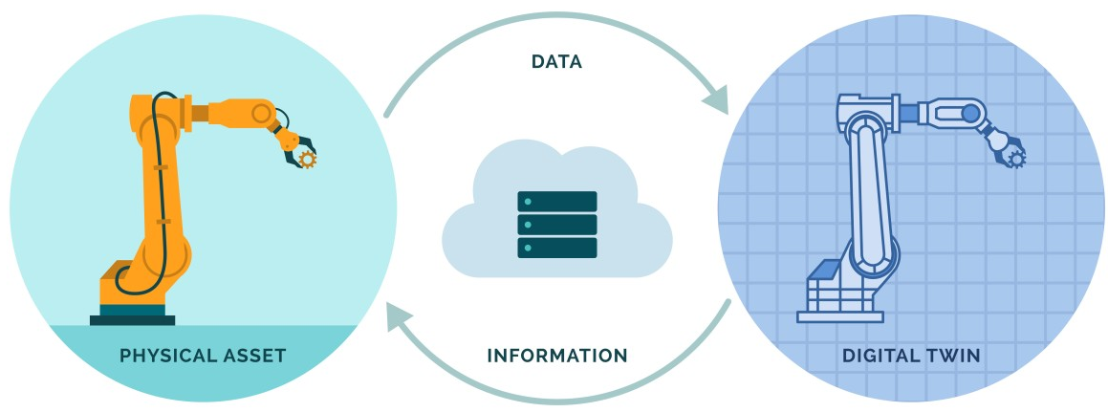
Digital Twin
01
Concept introduced as Mirroring Technology in 1960s by NASA to simulate systems for monitoring aircraft conditions.
Digital Twin is a virtual copy of something existing in the real world.
Examples:
Product twins (e.g., engines, cars)
Process twins (e.g., manufacturing lines)
System twins (e.g., smart cities, buildings)
Components
Real-world entity
Digital counterpart
Data connection (IoT, sensors, cloud)

Slide 4
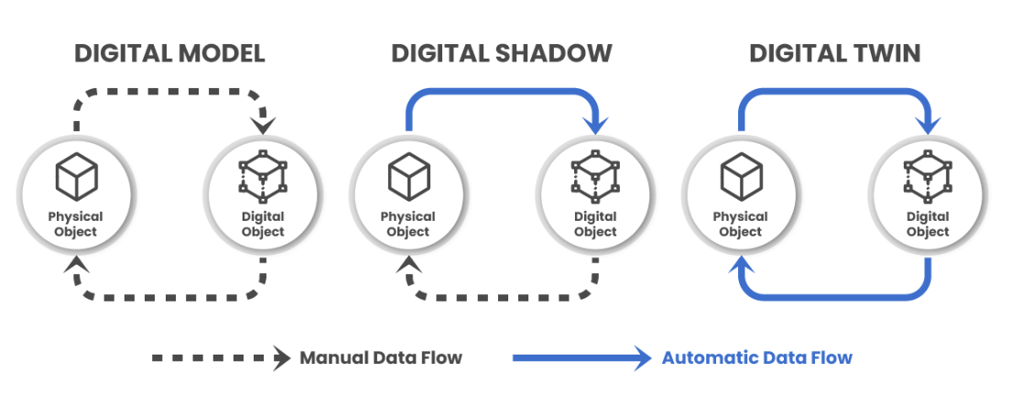
Digital Twin
01
TYPES
Based on the level of integration of technology with real world.
Development Process
Scan the Asset → Generate 3D Data Model → Develop an Analytical Model → Test →
Scale up the DT
Notes:
https://www.youtube.com/watch?v=mTRweA2DuKY
https://kongsbergdigital.com/products/ledaflow

Slide 5
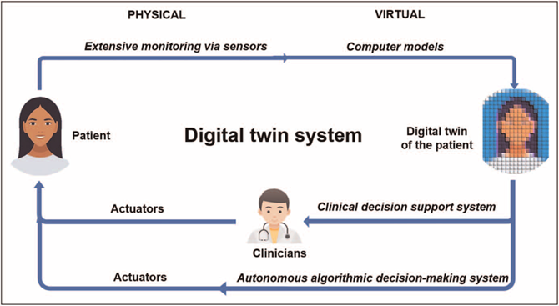
DT Mechanics
How it works?
02
Data collection from physical assets via IoT sensors
Real-time synchronization between physical and digital
AI & machine learning applied for analysis & prediction
Healthcare Use case

Slide 6
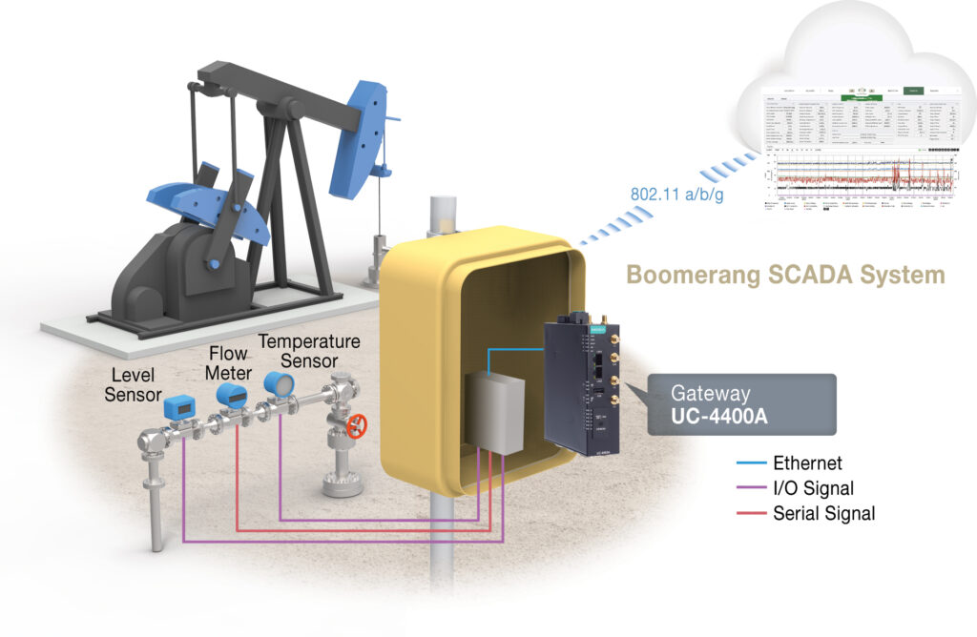
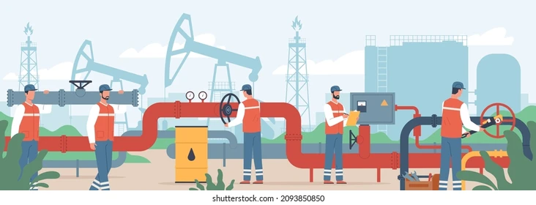
DT Mechanics
02
CATEGORIES
Virtual Digital Twins
Replicate the structure using Computer-aided design modelling and respectively tagging the area of interest for monitoring purpose. Replication of digitised environmental geography.
USE CASE: Oil & gas flow simulator to track CO2, hydrogen and steam emission tracking.
BENEFITS
Track hydrate inhibitors
Modelling wax deposition with pressure and temperature influence
CO2 injection seamless modelling of the interaction between well and reservoir systems
Courtesy: Moxa Americas Inc.
Notes:
https://www.youtube.com/watch?v=mTRweA2DuKY
https://kongsbergdigital.com/products/ledaflow

Slide 7
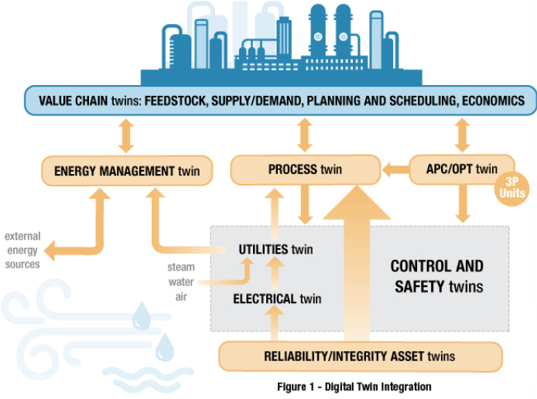
DT Mechanics
02
CATEGORIES
Process Digital Twins
Build on virtual twins to enable the digitalisation of entire processes. Digital mapping of all the sub-processes to complete any operational functionality.
For this category we need integration of:
Engineering data (P&IDs, 3D models, instrumentation)
Operational data (real-time sensor data, control systems)
Simulation models (steady-state and dynamic behaviour)
IMPLICATIONS
Data consistency across systems
Improved collaboration among departments
Automated updates and version control
Enhanced simulation accuracy using real-time data
Courtesy: Moxa Americas Inc.

Slide 8
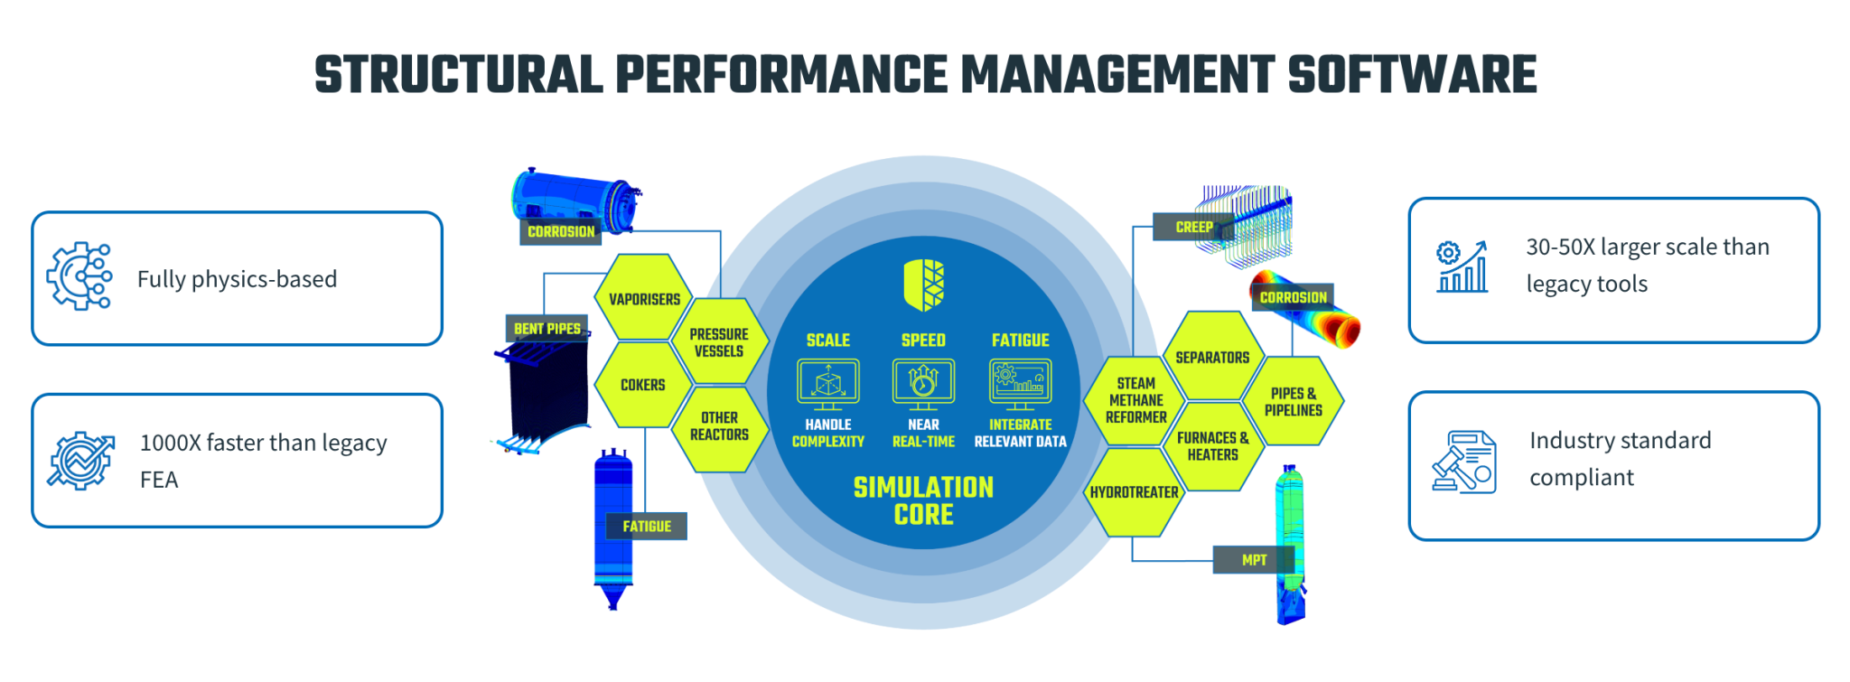
DT Mechanics
02
CATEGORIES
Structural Digital Twins
Fully parameterised, physics-based models delivering better results due to additional layer of system insight.
Structural simulation that blends high-fidelity, physics-based modelling with numerical efficiency.
Finite Element Analysis (FEA) is a computational method used to predict how a product or structure will behave under various conditions
Courtesy: Akselos
Notes:
Finite Element Analysis (FEA)
laws of physics

Slide 9
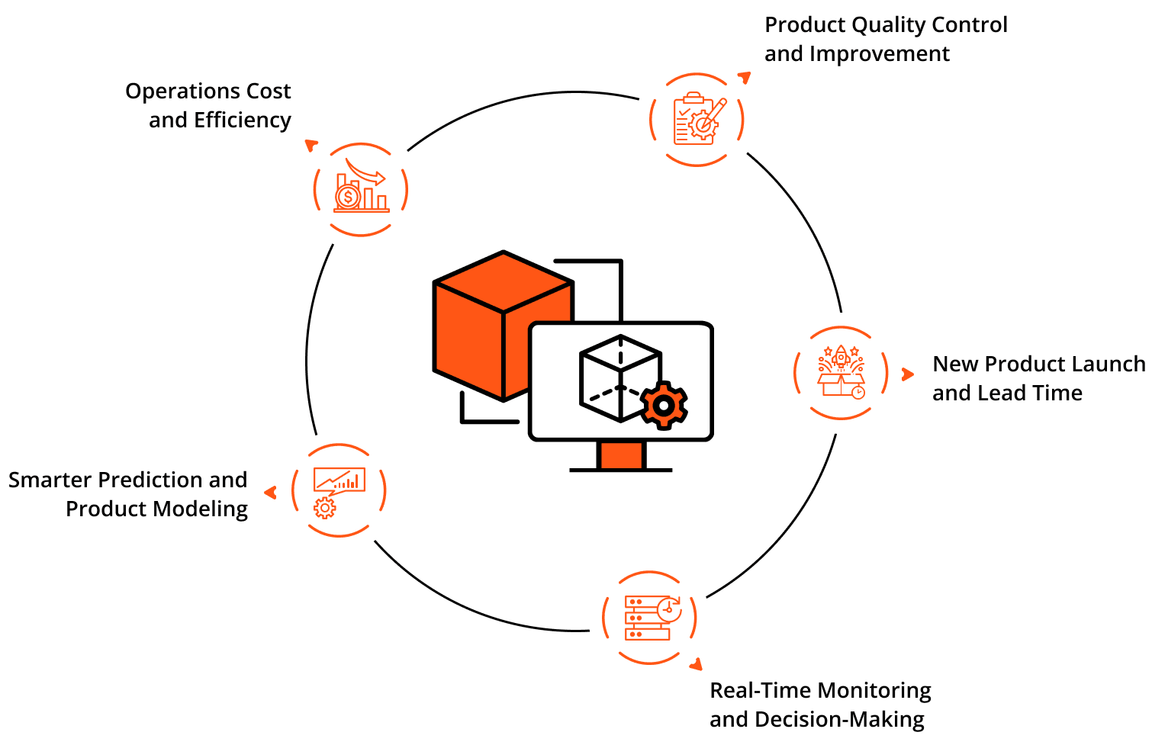
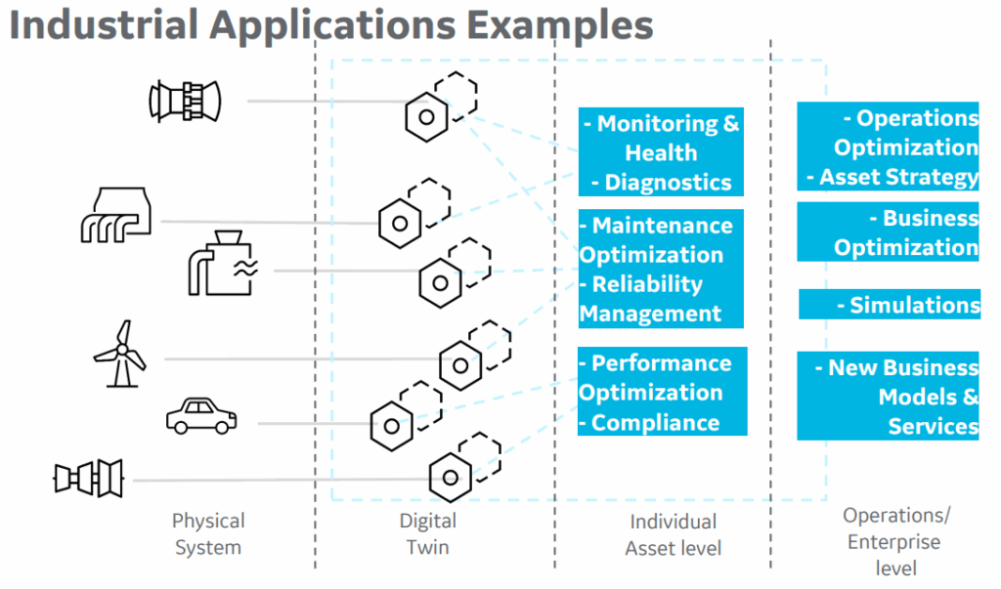
DT Mechanics
02
BENEFITS
Operational Efficiency: Predictive maintenance reduces downtime.
Design Optimization: Simulate and test before actual production.
Cost Savings: Lower maintenance & development costs.
Enhanced Decision Making: Real-time insights.
Sustainability: Optimize energy and resource usage.
Digital twin industrial applications
Courtesy: Moxa Americas Inc.
Notes:
Finite Element Analysis (FEA)
laws of physics

Slide 10
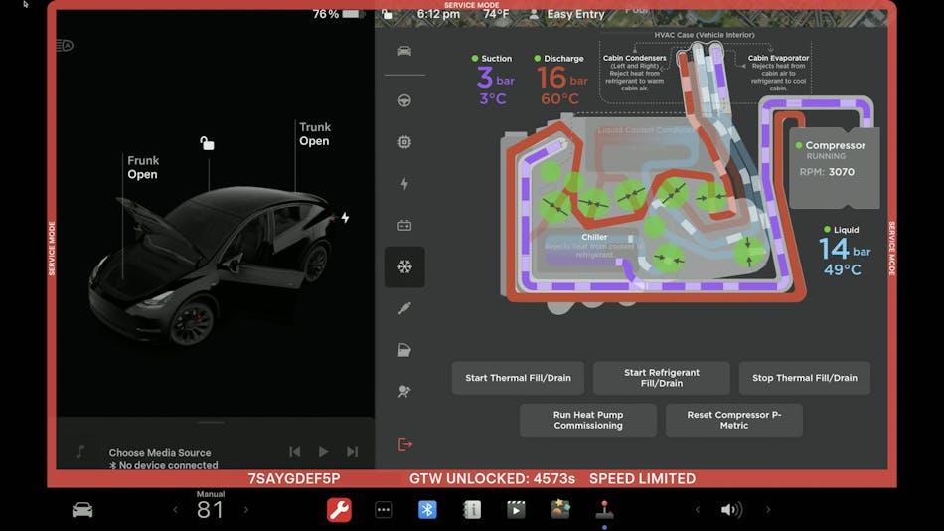
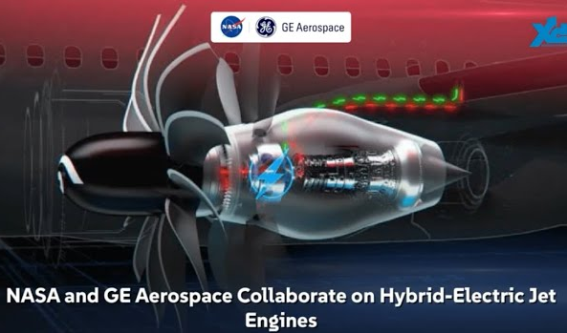
DT Applicability
03
INDUSTRY USE CASES
Tesla: Remote diagnostics of cars
GE Aerospace: Aircraft engine monitoring
Notes:
Finite Element Analysis (FEA)
laws of physics

Slide 11
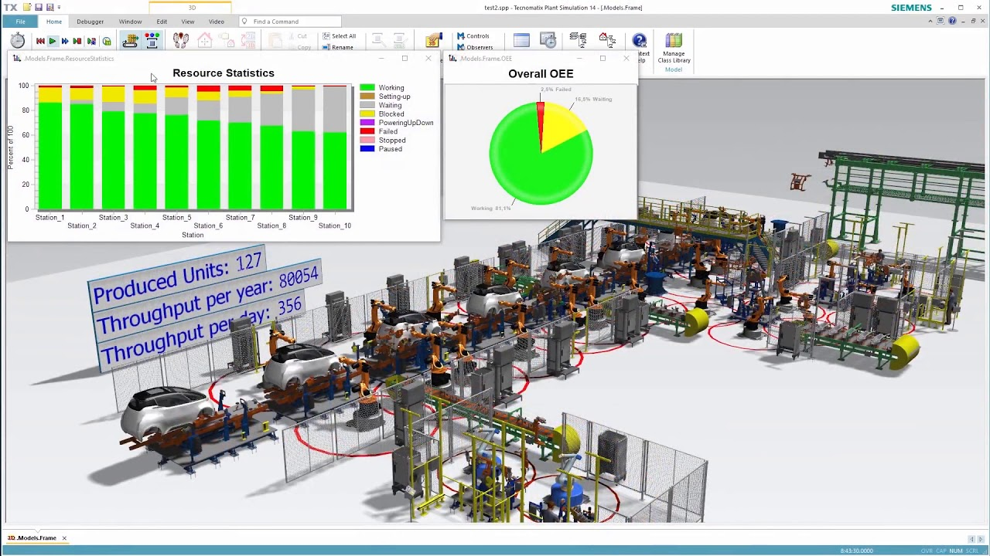
DT Applicability
03
INDUSTRY USE CASES
Siemens: Factory optimization
Notes:
Finite Element Analysis (FEA)
laws of physics

Slide 12
DT Applicability
03
Digital Twin Powered by GenAI
75 percent of large enterprises are actively investing in digital twins to scale AI solutions.
Four Key Aspects DT & Generative AI Enhance Each Other
Universal model creation: LLMs could initialize a foundational digital twin model, speeding up development.
Data handling: Gen AI can compress and embed large, real-time data streams for efficient use by digital twins and even generate synthetic data for training.
Natural-language interfaces: Multimodal Gen AI can translate complex twin data into intuitive insights and scenario prompts.
Validation & constraints: Digital twins provide real-world context and constraints, helping Gen AI outputs to be accurate, physically consistent, and safe
Notes:
By leveraging a software development platform such as GitHub, large language models (LLMs) can create code for the digital twin, accelerating the development process and increasing effectiveness.
Gen AI enhances digital twin creation, data handling, interpretation, and validation, and digital twins provide a trusted, contextual test-bed, organizations unlock safer, faster, and more cost‑efficient innovation and decision-making.

Slide 13
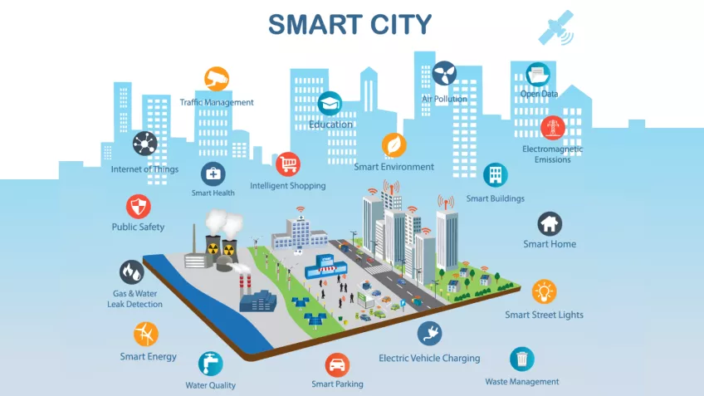
DT Applicability - GenAI
03
Notes:
https://www.mckinsey.com/capabilities/mckinsey-digital/our-insights/tech-forward/decoding-the-hype-cios-and-ctos-weigh-in-on-emerging-technologies
The architecture of a digital twin can be represented as nodes and edges in a time-series graph, allowing graph-based LLMs (such as GNN-LM, TextGNN, GIANT, and SimTeG) to create a basic model of a twin, whose design can then be built upon and adapted for various scenarios and industries.¹ For example, in a future smart-city context, various urban elements—such as traffic systems, public utilities, and environmental sensors—could feed into LLMs, which could identify and create potential connections between nodes in a graph. This lays the groundwork for simulating and predicting interactions and impacts over time.²

Slide 14



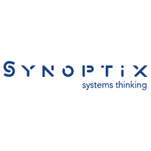










UK Job Market
04
High-Demand Roles
Digital Twin Developer / Engineer
Data Scientist (IoT)
Systems Architect (IoT, Cloud)
Simulation Specialist
Required Skills
IoT
AI/ML (PySpark ML Pipelines)
Cloud platforms (Azure Digital Twins, AWS TwinMaker)
Programming languages (C#, C++, python, R, Julia, MATLAB)
Platforms (Simulink, AutoCAD, Blender, Houdini)
Number of Jobs (UK, as of 13th august)
146 Jobs on Totaljobs
58 Jobs on ITJobsWatch
100+ jobs on Indeed
Top Employers
Average Salary
£29K - £41K/yr
Source: Glassdoor

Slide 15
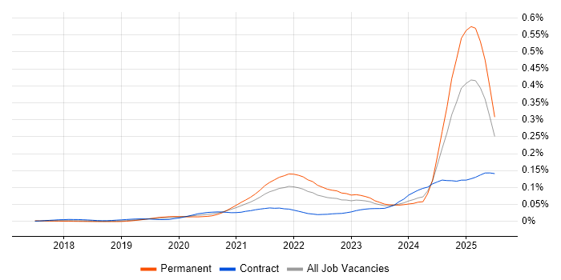
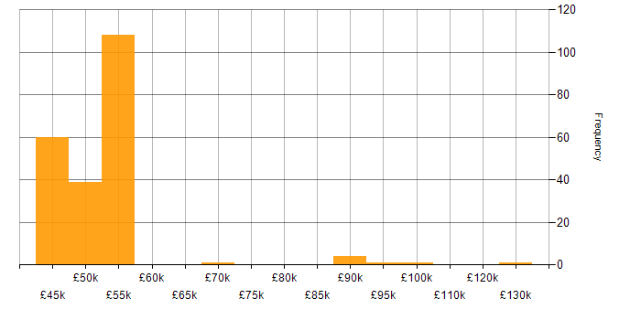
UK Job Market
04
Job postings citing Digital Twin as a proportion of all IT jobs advertised.
Salary distribution for jobs citing Digital Twin over the 6 months to 13 August 2025.
Source: https://www.itjobswatch.co.uk/jobs/uk/digital%20twin.do

Slide 16
UK Job Market
04
Government Fundings
National Digital Twin Programme (NDTP) → government-led programme
Develop the standards, processes, and tools that will build the foundation of a functioning market in digital twins.
Category | Details
NDTP Principles | Value-driven, open, transparent, inclusive, skill-building, standards-focused, governed
Digital Twin Criteria | Safe, secure, trustworthy, ethical, sustainable, adaptable, interoperable
Benefits to Measure | Business, government, societal, environmental
Who Can Contribute | Industries, companies (of any size), individuals via partnership, innovation, participation, advocacy

Slide 17
UK Job Market
04
Government Fundings
Ways to engage include with NDTP:
  Partnership: Collaborate on projects to shape digital twin technology.
  Innovation: Propose ideas or solutions for demonstrator programmes.
  Participation: Attend events, join discussions, and network with stakeholders.
  Advocacy: Help raise awareness of the NDTP’s mission and attract more contributors.
Contributors and collaborators come through partnerships with government, academia, and industry stakeholders
Your company should have supplier registration, as well as how to access technical resources and support.

Slide 18
UK Job Market
04
Government Fundings
Other open fundings:
  DIATOMIC Digital Accelerator for West Midlands-based innovators
    Available funding: £100K - £200K
    Deadline: 31/08/2025
    SMEs are eligible
    Focus Areas: Urban digital twins (West Midlands)
  UK Digital Twin Centre Accelerator
    Deadline: October 2025
    Focus Areas: Maritime, aerospace, defence

Slide 19
Start up Guide
05
Phase 1: Assessment
Identify physical asset(s) or process
Define KPIs & desired outcomes
Phase 2: Data Strategy
Install sensors / IoT infrastructure
Decide on data storage & transmission (cloud, edge computing)
Phase 3: Modelling & Simulation
Use 3D modelling (e.g., AutoCAD)
Select a Digital Twin platform (Azure, AWS, Ansys)
Phase 4: Integration
Connect real-time data
Implement AI/ML for insights
Phase 5: Scaling
Expand to more assets or systems
Automate decision-making feedback loops
#Tip: Start with a Digital Shadow before a full Twin for simplicity

Slide 20
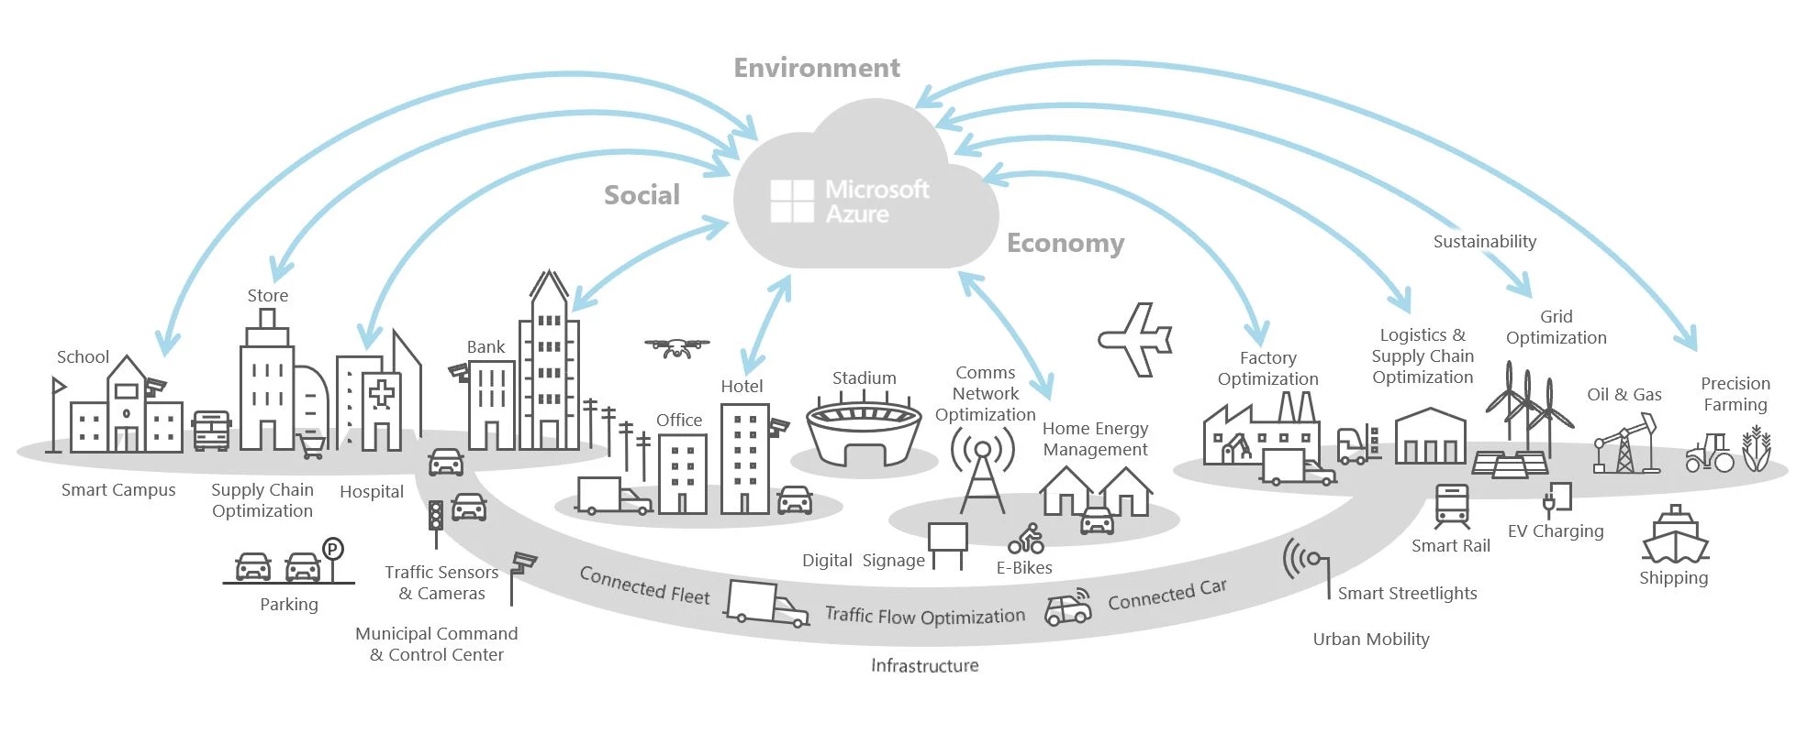
Start up Guide
05
Government Use Case: Digital Twin for Smart Traffic Management in an Urban City
Goal:
Monitor traffic flow in real time
Simulate effects of road closures or new traffic policies
Data Sensors:
Existing city sensors (traffic lights, CCTV) are integrated
New sensors deployed:
  Vehicle counting sensors
  Speed detectors
  Smart traffic signal controllers
Public transport GPS data integrated via APIs
Technologies Involved (Expected):
Function | Tools/Platforms
Data Collection | IoT sensors, GPS, CCTV
Digital Twin Platform | Azure Digital Twins, Cityzenith
Simulation & Analytics | Python, Azure ML, MATLAB
Mapping & 3D Models | Autodesk, CesiumJS
Visualization | Power BI, WebGL dashboards
Cloud Infrastructure | Azure, AWS TwinMaker

Slide 21
Way Forward
06
Challenges
High upfront cost
Data security & privacy
Integration complexity
Skilled individuals familiar with multiple platforms
Future Work
Integration with AI, AR/VR, blockchain
Twin of the Earth: climate & environmental modelling
Cognitive Twins: AI decision-making agents
Conclusion
Recap: Why digital twins are revolutionizing industries
Protip: Start small, scale fast
Notes:
Challenge → Solution
Data interoperability → Use of open standards like OPC UA and ISA-95
Model accuracy → Continuous calibration using live data
Cybersecurity → Segmented networks and secure data gateways
Scalability → Cloud-native solutions and containerization

Slide 22
Way Forward - Discussion
06
Possibilities (Researcher Point of View)
BritCard → national digital ID system for the UK to verify legal residency and citizenship more
Can be used to prove right to work, rent, or access services.
Unified portal for work, renting, banking, voting, health records, GPS locations, Social media interaction
Concerns
Majority Support → Over half support digital IDs, across political affiliations.
Apprehension Persists → A sizable minority distrust digital ID systems, especially regarding privacy and government competence.
Conditional Acceptance → Support hinges on strong safeguards—fairness, transparency, usability, and trust in implementation.
Solution
Secure & Private Design
User Control
Transparency & Communication
Civic Engagement & Co-design
Notes:
Data minimisation: Only collect what's strictly necessary (e.g., no location tracking).
Decentralised data storage: Avoid a single, hackable national database.
User control: Let people choose what data to share and with whom (like Apple Wallet or Estonia's e-ID).
Public consultations: Include communities, privacy groups, migrants, and the tech community early and often.
Regular updates & media engagement: Don’t let misinformation fill the silence.
Clear onboarding guides (in multiple languages and formats).
Digital confidence support: Free local training, helplines, explainer videos.
Community partnerships: Leverage trusted organisations to help educate and advocate.

Slide 23
Thanks!
Do you have any questions?
m.m.memon@ljmu.ac.uk

